Slide 1

Global Mart Sales Forecasting
By – Gantavya Banga

Slide 2

Table of content
21 Market Segment 3
COV analysis 5
Smoothing Techniques 7 -13
ARIMA Techniques 15 -19
MAPE and RSME Table 20
Conclusion 21

Slide 3
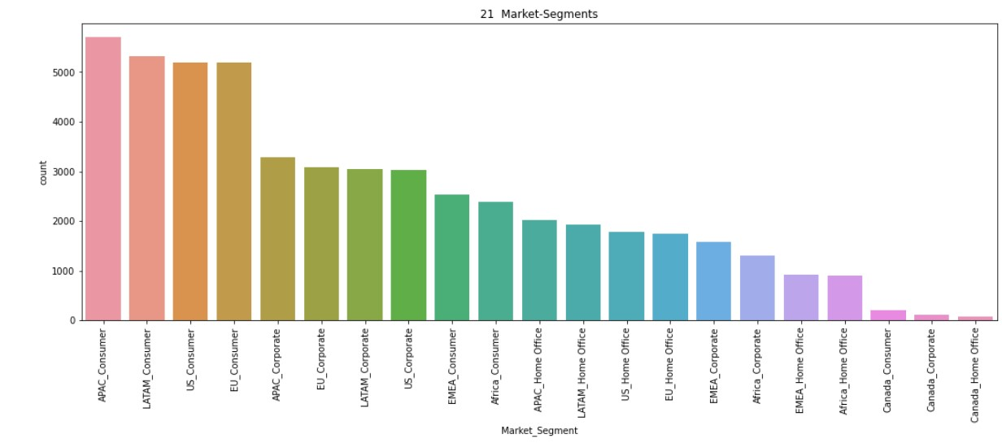
21 UNIQUE MARKET SEGMENTS
There are 3 Segments and 7 Markets in Total .
Market Segment is a combination of Segments and Markets.
These are the 21 unique Market Segments.
APAC _Consumer Market segment seems to be the most popular one as per the number of counts.

Slide 4
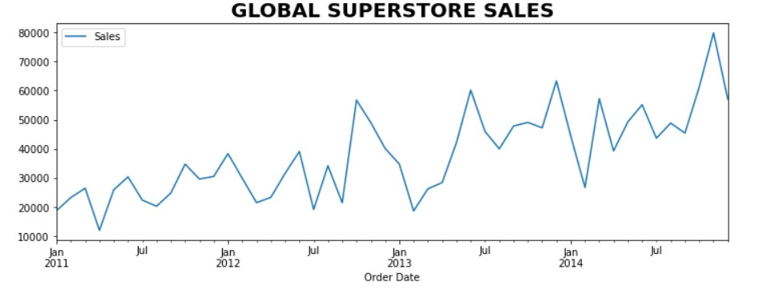
TIME SERIES ANALYSIS
From the sales data, We can observe that that the graph is following an upwards seasonal trends starting from Jan 2011 to July 2014.

Slide 5
COV as per the Profit
Market Segment COV
Coefficient of Variation (COV) is the ratio of the standard deviation and mean.
The Higher the COV value, the more fluctuating the series is.
The lower the COV, the more stable the series is .
Based on the COV table as per the profit, APAC_Consumer ‘Market Segment’ has got the lowest COV of 0.52 and is the most profitable and stable region.
Hence, we will be doing our Forecasting based on the APAC_Consumer “Market Segment”.
0 | APAC_Consumer | 0.522725
1 | APAC_Corporate | 0.530051
12 | EU_Consumer | 0.595215
15 | LATAM_Consumer | 0.683770
13 | EU_Corporate | 0.722076
16 | LATAM_Corporate | 0.882177
14 | EU_Home Office | 0.938072
2 | APAC_Home Office | 1.008219
18 | US_Consumer | 1.010530
19 | US_Corporate | 1.071829
20 | US_Home Office | 1.124030
17 | LATAM_Home Office | 1.169693
6 | Canada_Consumer | 1.250315
3 | Africa_Consumer | 1.310351
7 | Canada_Corporate | 1.786025
4 | Africa_Corporate | 1.891744
5 | Africa_Home Office | 2.012937
8 | Canada_Home Office | 2.369695
9 | EMEA_Consumer | 2.652495
10 | EMEA_Corporate | 6.355024
11 | EMEA_Home Office | 7.732073

Slide 6

Smoothing Forecast Techniques

Slide 7
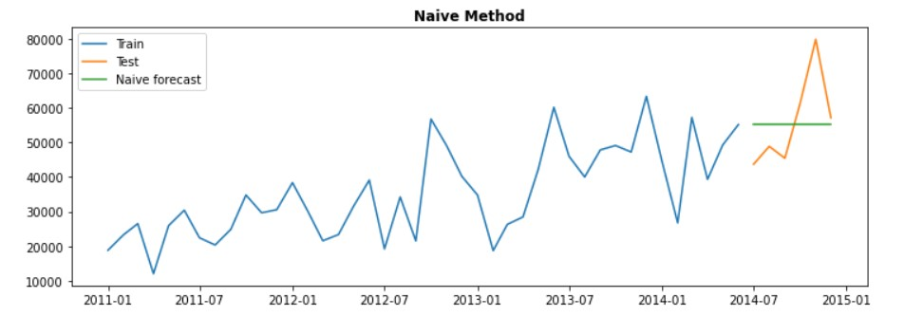
Smoothing Forecast Method - 1
Method | Naïve Method
RMSE | 12355.97
MAPE | 17.47
In Naive Forecast Method, we take the last observed value and use the same value to forecast it in the future values.
And we can observe in this case that after 2014-06, we just drew a straight line as a forecast for the next 6 months.
We got a MAPE value of 17.47 and RMSE value of 12355.97 for Naïve Method Forecasting

Slide 8
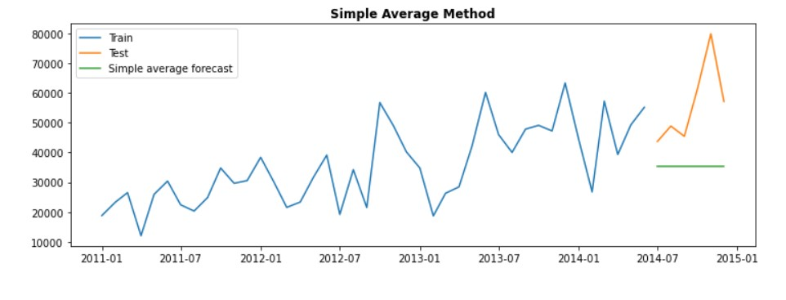
Smoothing Forecast Method - 2
Method | Simple average Method
RMSE | 24146.06
MAPE | 34.34
Forecast method: In Simple average Method, we take the average of the dataset and draw the line based on the average value to predict the future values
And we can observe in this case that after 2014-06, we just drew a green straight line as an average of the dataset to forecast for the next 6 months.
We got a MAPE value of 34.34 and RMSE value of 24146.06 for Simple Average Method

Slide 9
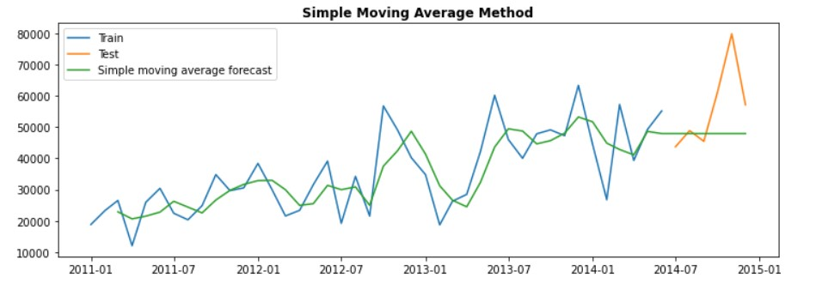
Forecast Method - 3
Method | Simple Moving average Method
RMSE | 14756.73
MAPE | 15.82
In Simple Moving average Method, we take the average of the last few observations to forecast the future
.
And we can observe that the green line is an average of the last few observations to forecast the future in this case
We got a MAPE value of 15.82 and RMSE value of 14756.73 for Simple Moving Average Method

Slide 10
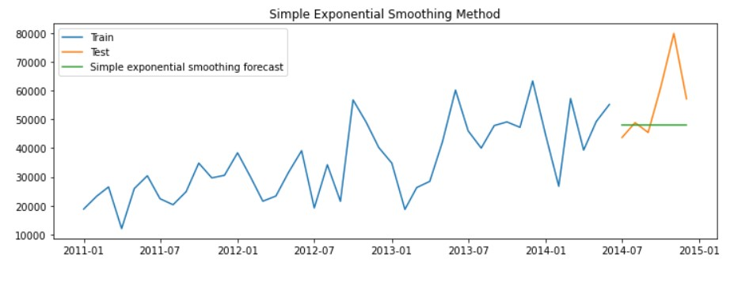
Smoothing Forecast Method - 4
Method | Simple exponential smoothing forecast
RMSE | 14627.34
MAPE | 15.74
In Simple exponential smoothing, we take the recent observations and multiply it with a smoothing factor to capture the level of the time series.
And we can observe that the green line is an average of the last few observations to forecast the future in this case
We got a MAPE value of 15.74 and RMSE value of 14627.34 for Simple exponential smoothing Method

Slide 11
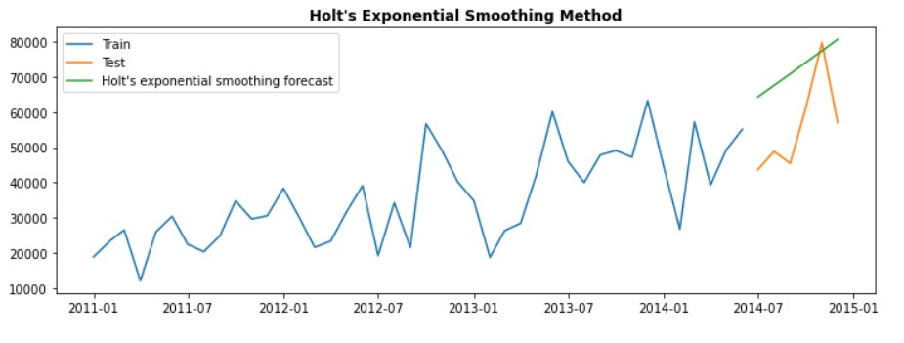
Smoothing Forecast Method - 5
Method | Holts Method
RMSE | 18976.37
MAPE | 34.57
Holts method captures the level and trends in the forecast to predict the future values.
And we can observe that the upwards straight green line is a forecast that predicts the future values.
We got a MAPE value of 34.57 and RMSE value of 18976.37 for Holts Exponential SmoothingMethod

Slide 12
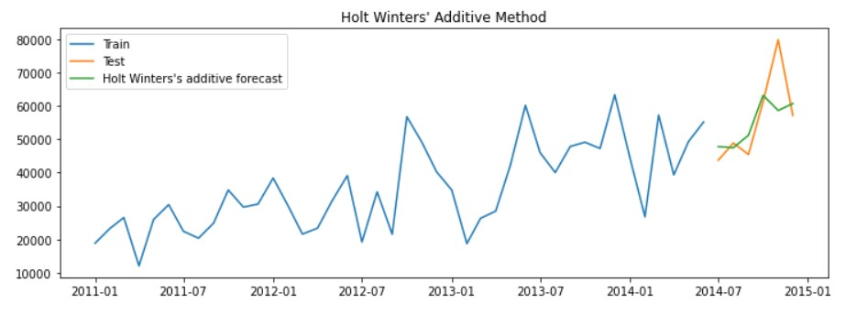
Smoothing Forecast Method - 6
Method | Holt Winters' additive method
RMSE | 9306.82
MAPE | 10.17
Holts winter additives method captures the level trends and seasonality in the forecast to predict the future values.
And we can observe that the green line is the forecast values in which we are able to predict the seasonal component as well..
We got a MAPE value of 34.57 and RMSE value of 18976.37 for Holt’s winter additives Method

Slide 13
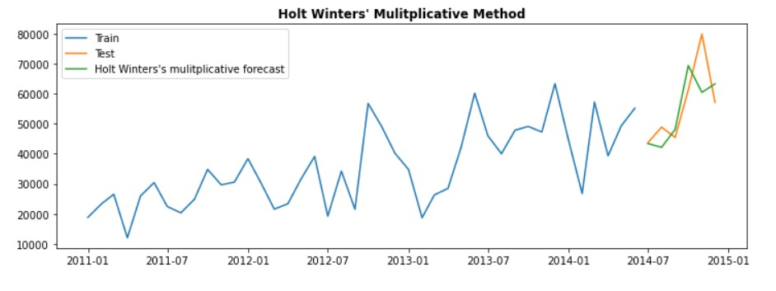
Smoothing Forecast Method - 7
Method | Holt’s winter Multiplicative method
RMSE | 9423.23
MAPE | 11.43
Holt’s winter Multiplicative method captures the level trends and seasonality in the forecast to predict the future values.
And we can observe that the green line is the forecast values in which we are able to predict the seasonal component as well..
We got a MAPE value of 11.43 and RMSE value of 9423.23 for Holt’s winter Multiplicative Method

Slide 14
ARIMA Forecast Techniques

Slide 15
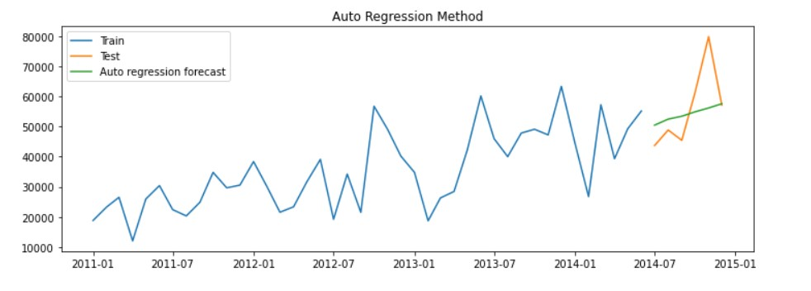
ARIMA techniques Forecast Method - 1
Method | Auto Regressive (AR) Method
RMSE | 10985.28
MAPE | 13.56
We can observe that the green line green line captures the trends but fails to capture the seasonality to predict the future observations
We got a MAPE value of 13.56 and RMSE value of 10985.28 for Auto Regressive (AR) Method.

Slide 16
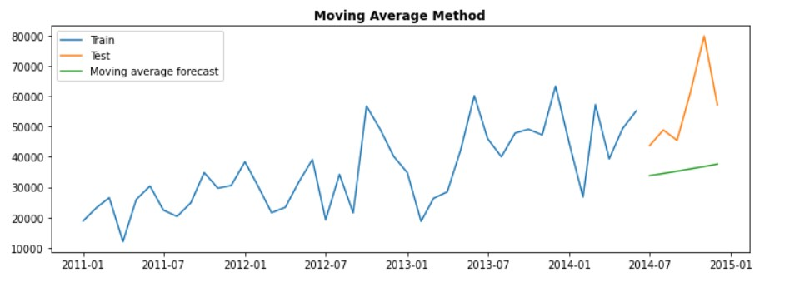
ARIMA techniques Forecast Method - 2
Method | Moving Average Method
RMSE | 23360.02
MAPE | 33.93
We can observe that the green line green line captures the trends but fails to capture the seasonality to predict the future observations
We got a MAPE value of 33.93 and RMSE value of 23360.02 for Moving Average Method.

Slide 17
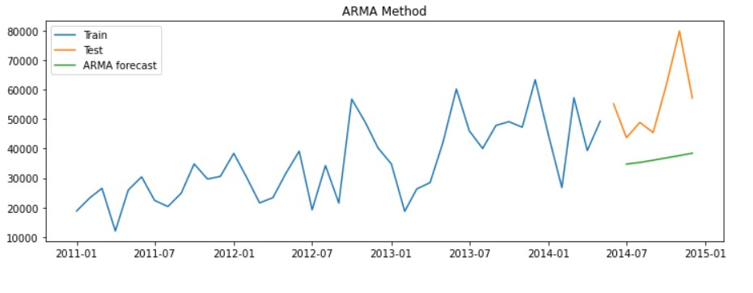
ARIMA techniques Forecast Method - 3
Method | Autoregressive moving average (ARMA) Method
RMSE | 22654.32
MAPE | 32.40
We can observe that the green line green line captures the trends but fails to capture the seasonality to predict the future observations
We got a MAPE value of 32.40 and RMSE value of 22654.32 for Autoregressive moving average (ARMA) Method.

Slide 18
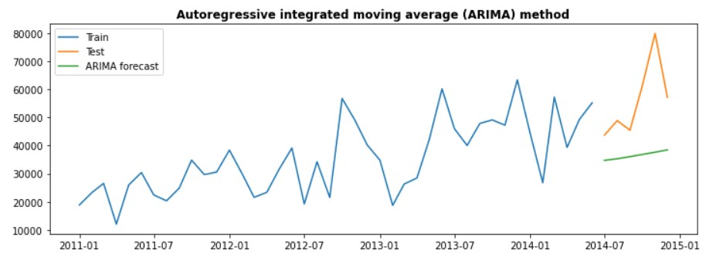
ARIMA techniques Forecast Method - 4
Method | (ARIMA) Method
RMSE | 22654.32
MAPE | 32.40
We can observe that the green line green line captures the trends but fails to capture the seasonality to predict the future observations
We got a MAPE value of 32.40 and RMSE value of 22654.32 for Autoregressive integrated moving average (ARMA) Method.

Slide 19
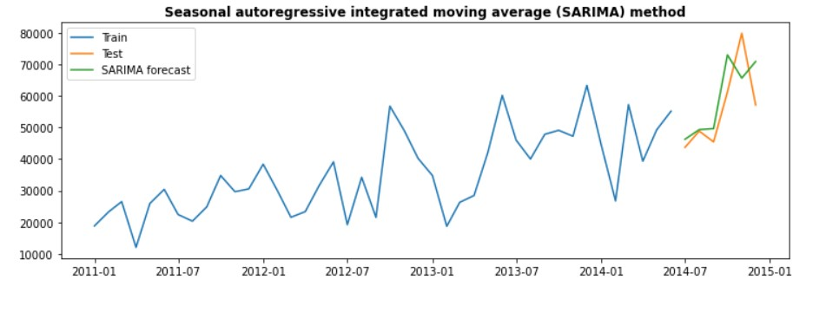
ARIMA techniques Forecast Method - 5
Method | (SARIMA) Method
RMSE | 22654.32
MAPE | 12.87
We can observe that the green line green line captures the trends and seasonality to predict the future observations
We got a MAPE value of 12.87 and RMSE value of 22654.32 for Seasonal Autoregressive integrated moving average (SARIMA) Method.

Slide 20
Best Smoothing Technique
We can observe that Holt Winter's additive method is the most efficient smoothing technique to forecast the sales for the future 6 months. It has got the lowest MAPE value of 10.17 and lowest RMSE value of 9306.82
Best ARIMA Technique
SARIMA is the best Auto regressive method with the lowest MAPE value of 12.87 and RSME value of 22654.32.
Final RSME & MAPE Table
 | Method | RMSE | MAPE
0 | Naive method | 12355.97 | 17.47
0 | Simple average method | 24146.06 | 34.34
0 | Simple moving average forecast | 14756.73 | 15.82
0 | Simple exponential smoothing forecast | 14627.34 | 15.74
0 | Holt's exponential smoothing method | 18976.37 | 34.57
0 | Holt Winters' additive method | 9306.82 | 10.17
0 | Holt Winters' multiplicative method | 9423.23 | 11.43
0 | Autoregressive (AR) method | 10985.28 | 13.56
0 | Moving Average (MA) method | 23360.02 | 33.93
0 | Autoregressive moving average (ARMA) method | 22654.32 | 32.40
0 | Autoregressive integrated moving average (ARIM... | 22654.32 | 32.40
0 | (SARIMA) Seasonal autoregressive integrated mo... | 22654.32 | 12.87

Slide 21
CONCLUSION
Method | Holt Winters' additive method
RMSE | 9306.82
MAPE | 10.17
We are going to choose Holt Winters' additive method as a final forecasting method as it works the best for the sales forecast.
This method captures the level trends along with the seasonality
And we can observe that the green line is the forecast values in which we are able to predict the seasonal component as well..

